Slide 1

SMS Spam Classifier
Prachal, Ian, Umar, Hamza

Slide 2

General Outline
Basic Project Guideline:
What do we want to achieve with our dataset?
How can we achieve this?
What results are we looking for?
What conclusions can we make?

Slide 3
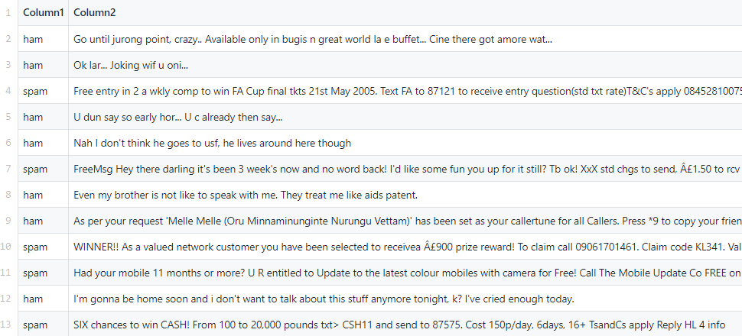
SMS Dataset - Overview
‘Type’ column
Spam/Ham label(s)
‘Message’ column
Set of SMS messages
SMS involve wide range of characters
~ 5500 rows

Slide 4
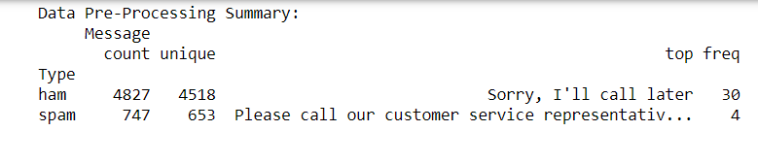
Initial Data Analysis
General summary of dataset
Python function – describe()
Plot certain counts
Python function – value_counts()
Overall, gives us a way to visually
understand our data

Slide 5


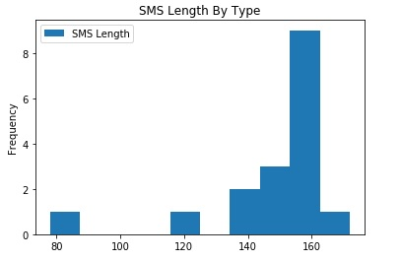
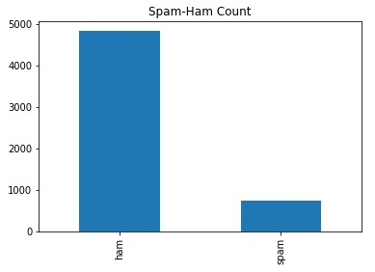

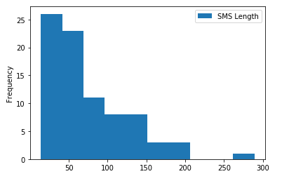
Data Preprocessing
Format text:
Remove punctuations
Convert messages to lowercase
Remove stopwords
Makes data simpler and easier to process

Slide 6

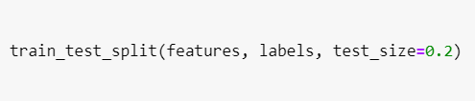
Data Processing
Format dataset:
Update CSV with processed messages
Compare lengths (before and after processing)
Split data – train_test_split()
Processed messages
x_train and x_test (Features)
Type (Spam/Ham)
y_train and y_test (Labels)

Slide 7
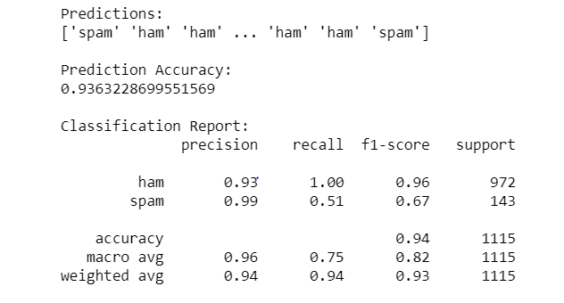
Classification
kNN Classifier
Predict using k neighbors (k = 10, 100, 1000…)
From kNN, we got:
Accuracy Score
Classification Report
Confusion Matrix

Slide 8

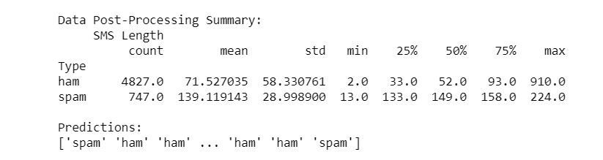

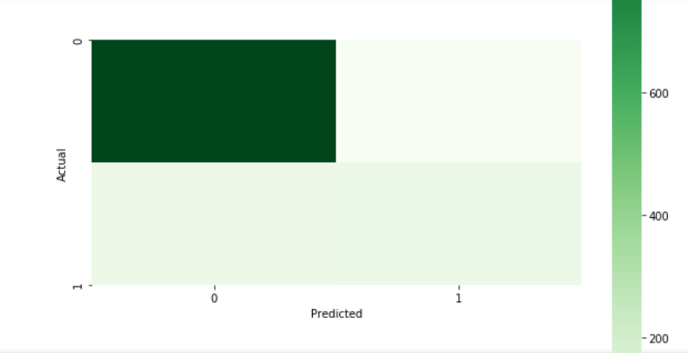
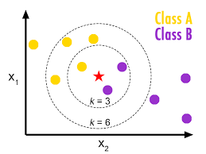

Slide 9
Results & Conclusions

Slide 10
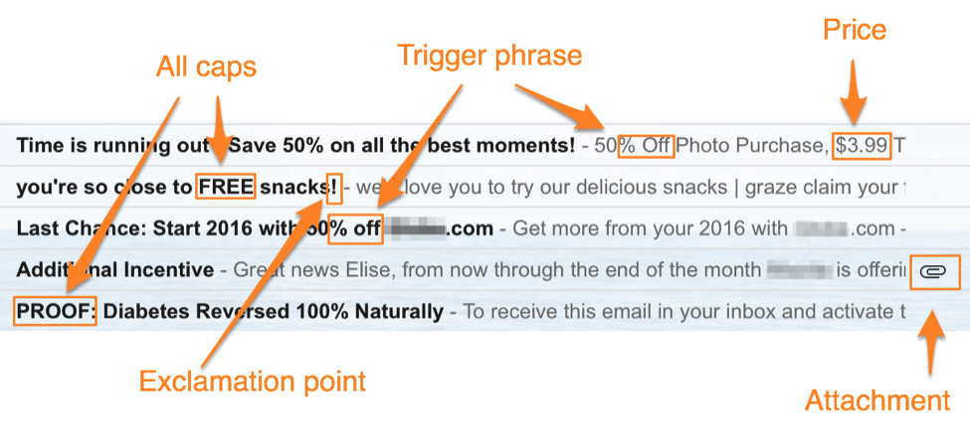
Real-World Applications
Machine learning can be used to automatically filter out messages before they even reach the user
This is exactly what Gmail’s spam filter does

